Slide 1
PYTHON
Lecture - 04

Slide 2
Recap
Variable
Data Type (Numeric, String basic, Boolean)
Casting
Homework
Class work
Write a python program that produce the result summation, subtraction, multiplication and division of two numbers and print the all 4 results by a single print function.

Slide 3
Contents
Python User Input
Print Output with format
Operators
Python Conditions and If…Else statements

Slide 4
Print Output with format
Basic Usage: print("Hello")
Multiple Items: print("a =", a, "b =", b)
sep Parameter: print("a", "b", "c", sep=", ")
end Parameter: print("Hello", end=" World!")
Concatenation: print("Hello, " + name + "!")
str.format(): print("Name: {}, Age: {}".format(name, age))
F-Strings: print(f"Name: {name}, Age: {age}")
Formatting Specifiers: print(f"{pi:.2f}")
Number Systems: print(f"{number:b}")
Escaping: print("He said, \"Hello!\"")

Slide 5
Python Operators
Operators are used to perform operations on variables and values.
Python divides the operators in the following groups:
Arithmetic operators
Assignment operators
Comparison operators
Logical operators
Identity operators
Membership operators
Bitwise operators

Slide 6
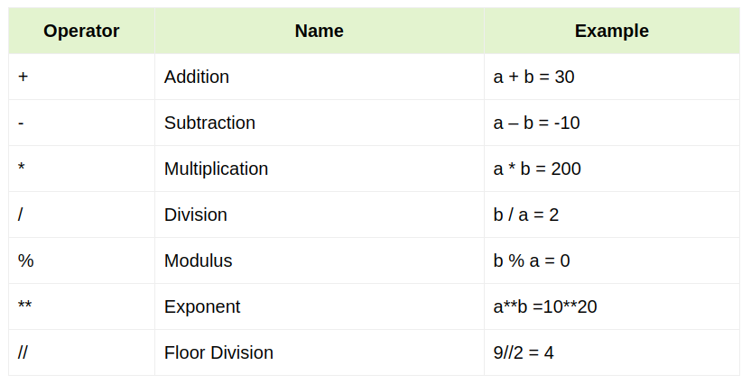
Arithmetic Operators in Python
(Let a=10 and b=20)

Slide 7
Arithmetic Operators in Python
a = 5
b = 3
c = a + b
print ("a: {} b: {} a+b: {}".format(a,b,c))
c = a / b
print ("a: {} b: {} a/b: {}".format(a,b,c))
c = a//b
print ("a: {} b: {} a//b: {}".format(a,b,c))
c = a % b
print ("a: {} b: {} a%b: {}".format(a,b,c))
c = a**b
print ("a: {} b: {} a**b: {}".format(a,b,c))
OUTPUT
a: 5 b: 3 a+b: 8
a: 5 b: 3 a/b: 1.6666667
a: 5 b: 3 a//b: 1
a: 5 b: 3 a%b: 2
a: 5 b: 3 a**b: 125

Slide 8
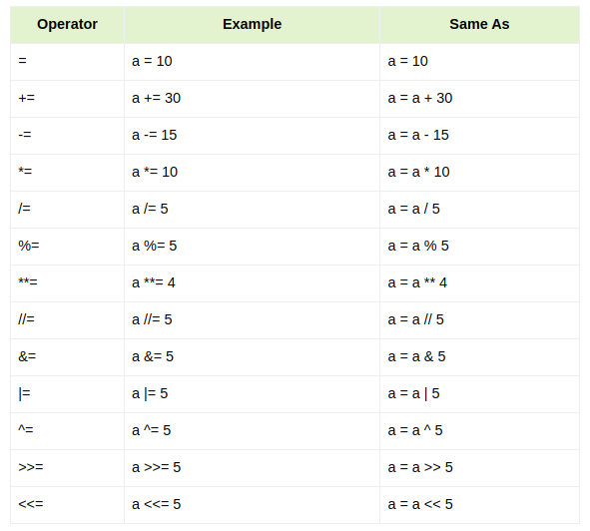
Assignment Operators in Python

Slide 9
Assignment Operators in Python
a = 21
b = 10
c = 0
c += a
print ("a: {} c += a: {}".format(a,c))
c *= a
print ("a: {} c *= a: {}".format(a,c))
c /= a
print ("a: {} c /= a : {}".format(a,c))
c = 2
print ("a: {} b: {} c : {}".format(a,b,c))
c %= a
print ("a: {} c %= a: {}".format(a,c))
OUTPUT
a: 21 c += a: 21
a: 21 c *= a: 441
a: 21 c /= a : 21.0
a: 21 b: 10 c : 2
a: 21 c %= a: 2

Slide 10
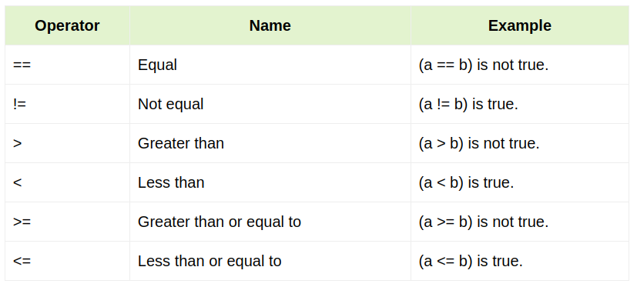
Comparison Operators in Python

Slide 11
Comparison Operators in Python
a = 21
b = 10
if ( a == b ):
print ("a is equal to b")
else:
print ("a is not equal to b")
a,b = b,a #values of a and b swapped.
if ( a <= b ):
print ("a is either less than or equal to b")
else:
print ("a is neither less than nor equal to b")
OUTPUT
a is not equal to b
a is either less than or equal to b

Slide 12
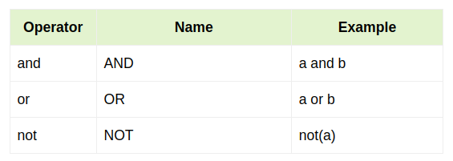
Logical Operators in Python

Slide 13
Logical Operators in Python
var = 5
print(var > 3 and var < 10)
print(var > 3 or var < 4)
print(not (var > 3 and var < 10))
OUTPUT
True
True
False

Slide 14
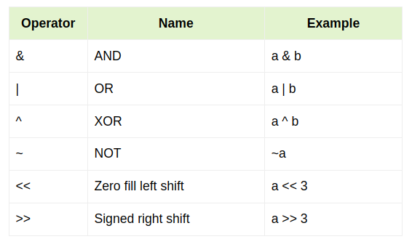
Bitwise Operators in Python

Slide 15
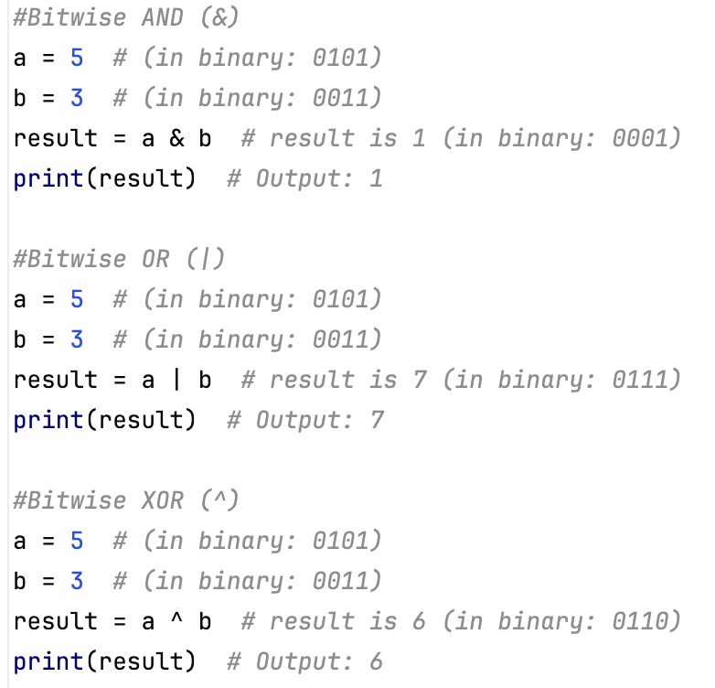
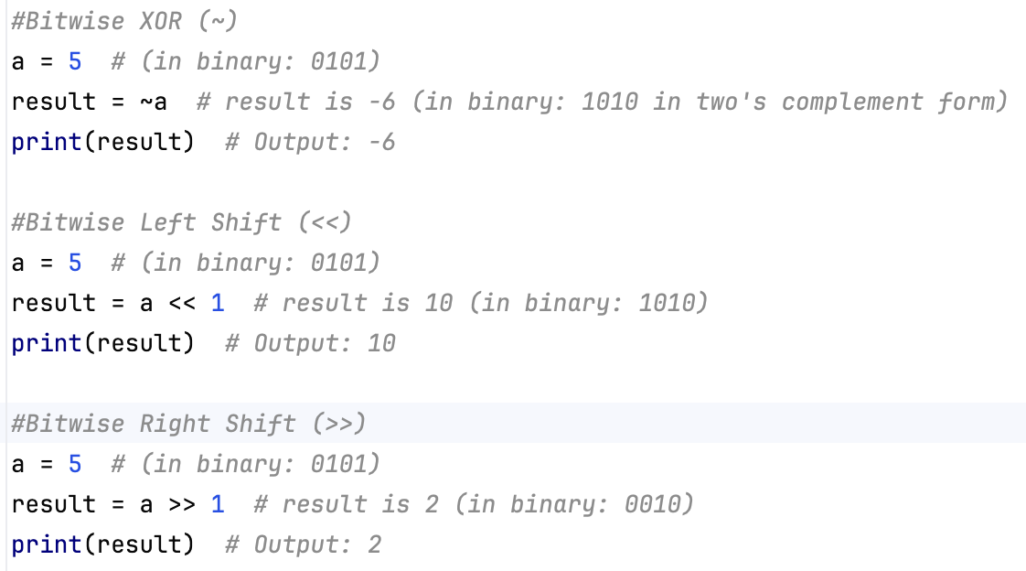
Bitwise Operators (example)

Slide 16
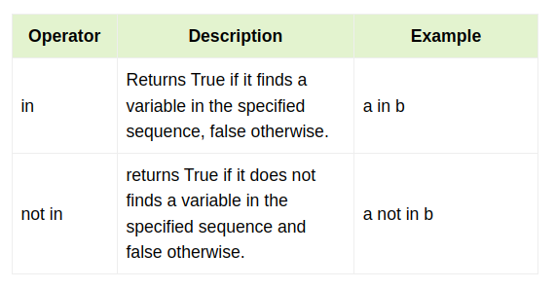
Membership Operators in Python

Slide 17
Membership Operators in Python
a = 10
b = 5
list = [1, 2, 3, 4, 5 ]
if ( a in list ):
print ("a is present in the given list")
else:
print ("a is not present in the given list")
if ( b not in list ):
print ("b is not present in the given list")
else:
print ("b is present in the given list")
OUTPUT
a is not present in the given list
b is present in the given list

Slide 18
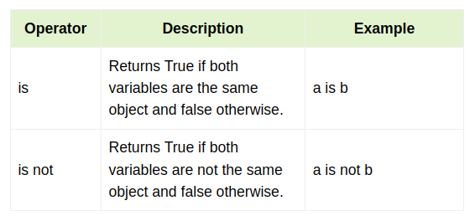
Identity Operators in Python

Slide 19
Identity Operators in Python
a = [1, 2, 3, 4, 5]
b = [1, 2, 3, 4, 5]
c = a
print(a is c)
print(a is b)
print(a is not c)
print(a is not b)
OUTPUT
True
False
False
True

Slide 20
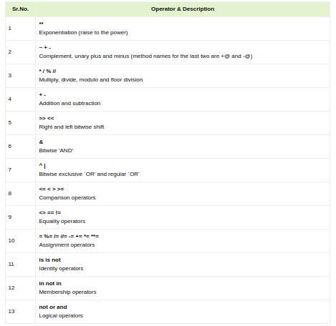
Operators Precedence
The following table lists all operators from highest precedence to lowest.

Slide 21
Exercise
Write a program that takes three number from user/keyboard and print their sum.

Slide 22

Decision Making Statements

Slide 23
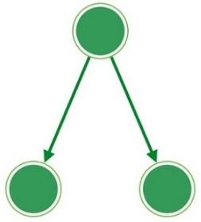
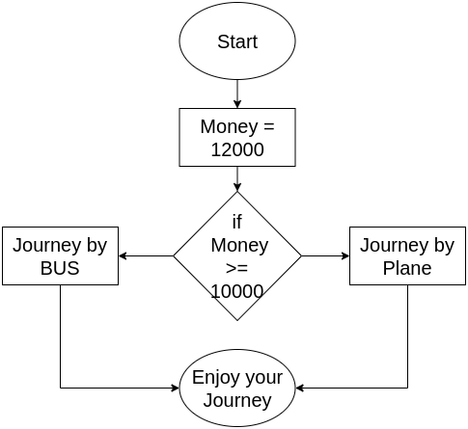
What is Decision Making?
Decision making means what should we do in a circumstances.
The flowchart helps you to decide what should you choose in the time of travel.
No
Yes

Slide 24
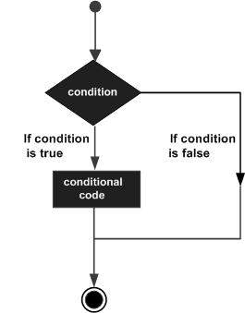
Python Decision Making (if Statement)
if Statement Syntax
if expression:
statement(s)

Slide 25
Python Conditions
Python supports the usual logical conditions from mathematics:
Equals: a == b
Not Equals: a != b
Less than: a < b
Less than or equal to: a <= b
Greater than: a > b
Greater than or equal to: a >= b
An "if statement" is written by using the if keyword.
For two conditions we use if and else
For more than two conditions we use if… elif…. else

Slide 26
Python Conditions (Examples)
See the following code
a = 33 b = 200 if b > a: print("b is greater than a")
Indentation:
Python relies on indentation (whitespace at the beginning of a line) to define scope in the code.
Other programming languages often use curly-brackets for this purpose.

Slide 27
Examples: If-elif-else
If-elif
a = 33 b = 33 if b > a: print("b is greater than a") elif a == b: print("a and b are equal")
If-elif-else
a = 200 b = 33 if b > a: print("b is greater than a") elif a == b: print("a and b are equal") else: print("a is greater than b")

Slide 28
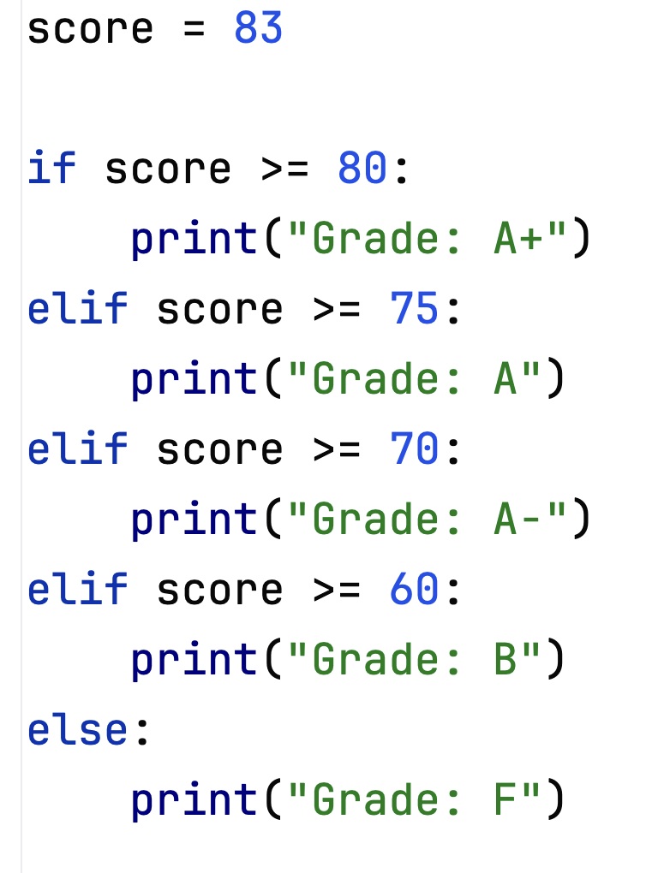
Exercises:
Calculate Grade based on a given score.
[Note: score>=80→ A+, score>=75 → A, score>=70→ A- and score >=60 →B unless Failed]

Slide 29
Exercises:
Let's consider an example of a customer entitled to 10% discount if his purchase amount is > 1000. if not, then no discount is applicable. Given his purchase amount, find out the payable amount
purchaseAmount = 1250
payableAmount = purchaseAmount
if(purchaseAmount>1000):
payableAmount -= purchaseAmount*0.1
print(payableAmount)

Slide 30
Exercises:
You can vote if your age is more or equal to 18. Now, given an age, find if s/he can vote or not?
age = 20
if age >= 18:
print("s/he can vote")
else:
print("s/he can't vote")

Slide 31
Exercises:
You are given 3 numbers. Find out the largest number.
a,b,c = map(int,input().split(" "))
if(a>=b and a>=c):
print(a)
elif(b>=c):
print(b)
else:
print(c)

Slide 32
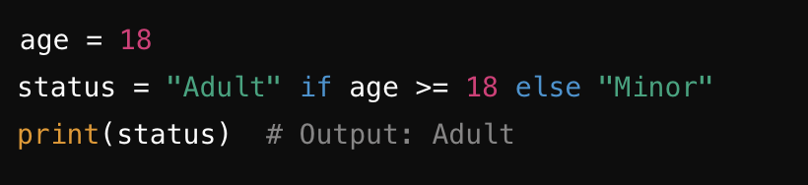
Ternary Operators
A ternary operator in Python, also known as a conditional expression, is a way to write a simple if-else statement in a single line.
It's a concise way to perform conditional assignments or return values based on a condition.
value_if_true if condition else value_if_false
condition: The condition that is evaluated.
value_if_true: The value that is returned if the condition is True.
value_if_false: The value that is returned if the condition is False.

Slide 33
Python User Input
Python allows for user input. That means we are able to ask the user for input.
Python (3.6+) uses the input() method.
yourname = input("Enter Your Name:") print(”Your name is: " + yourname)
More examples:
name = input("Enter your name : ")
city = input("Enter your city : ")
print ("Hello My name is", name)
print ("I am from ", city)

Slide 34
Examples
Calculate area of a rectangle from a given height and width. Take input from user/keyboard.
width = input("Enter width : ")
height = input("Enter height : ")
area = width*height
print ("Area of rectangle = ", area)
Find the problem and solve it.

Slide 35
Converting User Input to Other Data Types
Input() function takes input (usually from the keyboard) and returns it as a string.
You can then convert this input to other data types, such as integers or floats, if needed.
width = int (input("Enter width : "))
height = int(input("Enter height : "))
area = width*height
print ("Area of rectangle = ", area)
Find the problem and solve it.

Slide 36
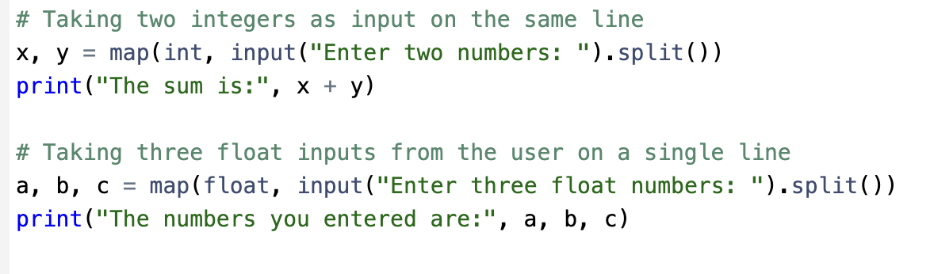
Multiple input in a single line
input(): This function reads a line of input from the user.
split(): This method splits the input string into a list of substrings based on spaces.
map(float/int, ...): This converts each substring into a float/int.

Slide 37
E X E R C I S E

Slide 38
Exercise – 4.1
You are given 3 numbers. Find out the largest number.
Sample Input: 4 2 7
Sample Output: 7
Bonus-1: What if - you are given 5 numbers?
Bonus-2: What if - you are given 10 numbers?

Slide 39
Exercise – 4.1 (ans)
# a,b,c = map(int,input().split(" "))
a = int(input())
b = int(input())
c = int(input())
if(a>=b and a>=c):
print(a)
elif(b>=c):
print(b)
else:
print(c)

Slide 40
Exercise – 4.2
Given a year, Find it is Yeap-Year or not.
Sample Input: 2000
Sample Output: “Leap Year”
Sample Input: 2023
Sample Output: “Not Leap Year”

Slide 41
Exercise – 4.2 (ans)
year = int(input())
flag = 0 # 1 means leap year, otherwise 0
if year % 400 == 0:
flag = 1
elif year%100 != 0 and year%4 == 0:
flag = 1
if(flag):
print("Leap Year")
else:
print("Not Leap Year")

Slide 42
Thank You

Slide 43
Resources
https://www.tutorialspoint.com/python/index.htm
https://www.w3resource.com/python/python-tutorial.php
https://www.w3resource.com/python-exercises/string/
https://www.w3schools.com/python/
https://www.geeksforgeeks.org/python-programming-language/
https://youtu.be/t2_Q2BRzeEE?si=OO6J_YNCZykedqsT
https://realpython.com/
Head First Python, 3rd Edition by Paul Barry
Automate the Boring Stuff with Python By Al Sweigart.

Slide 44
Thank You

